Slide 1

An Introduction to Data Clustering
Dr. Risman Adnan Mattotorang
Telkom University

Slide 2

Outline – Data Clustering
Definition of Clustering
Features Selection and Extraction
Clustering Models and Algorithms
Clustering Validation Measures
Other Frameworks and Libraries

Slide 3
Clustering Problems
Non-Formal Definitions:
Similarity View: Given a dataset, partition them into a set of groups which are as similar as possible.
Distance View: Given a dataset, find an aggregate of points in the test space such that the distance between any two points in the cluster is less than the distance between any point in the cluster and any point not in it.
Probability View: Given a dataset, find a continuous regions of data space (dimensional feature space) containing a relatively high density of points, separated from other such regions by regions containing a relatively low density of points.
Attention: Formal definition is not only difficult but may even be misplaced.

Slide 4
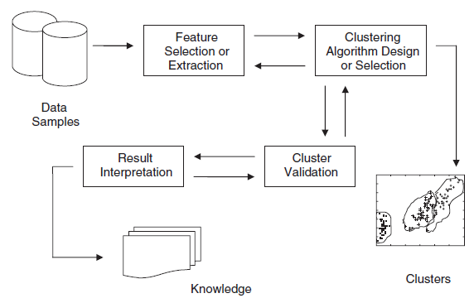
Clustering in EDA Process
We use clustering to understand the data without label:
Data Samples
Feature Selection
Cluster Visualization
Cluster Validation
Result Interpretation
Knowledge/Insights
ML Model Selection
Technique
Centered
Data Type
Centered

Slide 5
Application Domain of Clustering
Common Use Cases of Clustering:
Exploratory and Intermediate Phase in ML Modeling
Summarization Phase of Collaborative Filtering
Automatic Customer Segmentation
Dimensionality Reduction and Data Summarization
Dynamic Detection for Streaming Data
Multimedia Data Analysis Eg. Image, Audio, Videos
Various Use Cases in Biological Data Analysis
Various Use Cases in Social Network Analysis
Many more ….
Technique
Centered
Data Type
Centered

Slide 6
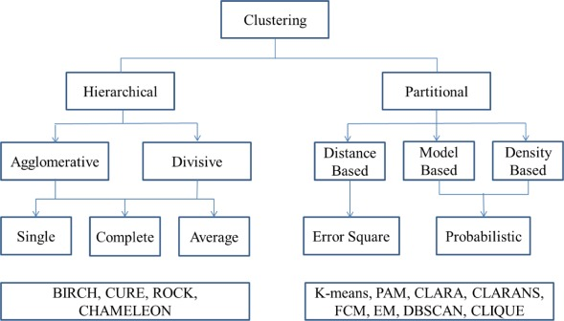
Categories of Clustering Techniques
Hundreds Methods and Techniques in These Categories:
Features Selection (Partitioning) Methods
Probabilistic and Generative Models
Distance-Based Algorithms (Flat vs Hierarchical)
Density and Grid-Based Methods
Leveraging Dimensionality Reduction Methods
High-Dimensionality Scenarios
Scalable Techniques for Clustering Analysis
Attention: The clustering problems can be addressed using a wide variation of methods..

Slide 7
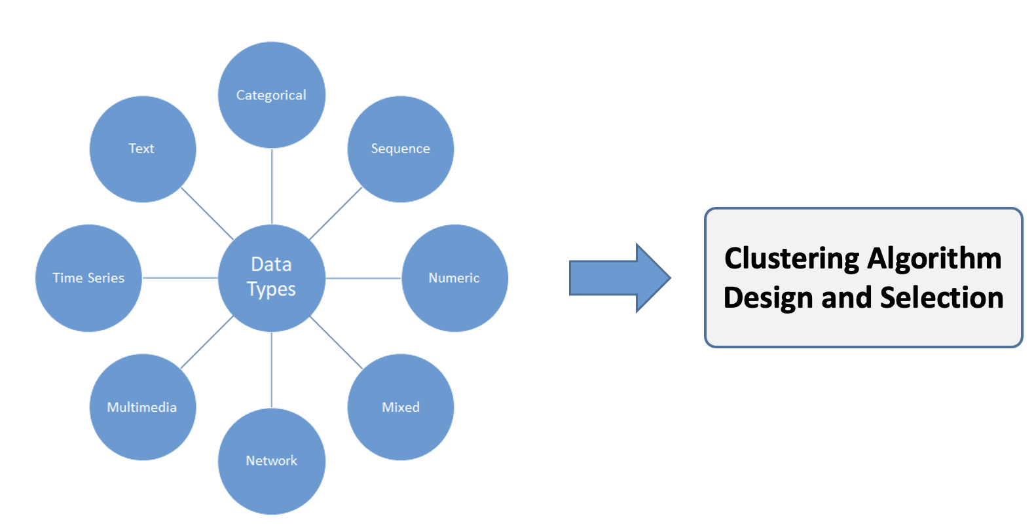
Categories of Clustering Data Types
Many Methods and Techniques :
Categorical
Text Data
Multimedia
Time-Series
Discrete Sequence
Network Data
Uncertain Data

Slide 8
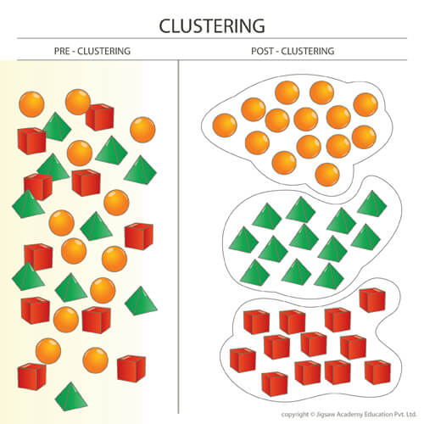
Interpretation of Clustering
How do we know that a particular clustering is good or that it solves the needs of the application?
Visual Insights (HD-Eye, IPCLUS)
Supervised Insights
Multiview and Ensemble-Based Insights
Validation-Based Insights

Slide 9
Outline – Data Clustering
Definition of Clustering
Features Selection and Extraction
Clustering Models and Algorithms
Clustering Validation Measures
Other Frameworks and Libraries

Slide 10
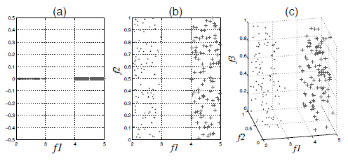
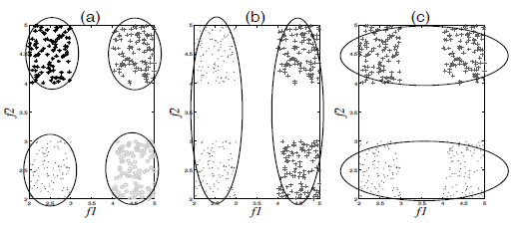
Features Selection for Clustering
Facts:
Removing features don’t affect clustering accuracy
Difference features produce different clusters
Features Selection for Clustering:
Filter
Wrapper
Hybrid
Data Types & Algorithms:
Generic, Text, Streaming, Linked data

Slide 11
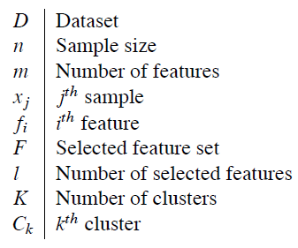
Filter Model
Characteristics:
Do not utilize any clustering algorithms.
Evaluate score of each feature according to certain criteria.
Select features with highest scores.
Features evaluation could be either univariate and multivariate.
Univariate = feature is evaluated independently of the feature space.
Multivariate can handle redundant features.
Example of Methods:
Spectral Feature Selection (SPEC)
Feature Dependency
Entropy-Based Distance
Laplacian Score

Slide 12
Wrapper Model
Characteristics:
Utilize clustering algorithms to evaluate features.
Heuristic search strategy to reduce the search space.
How it works: Finding subset of features, evaluate, repeat.
Computationally expensive compared to filter model.
Produce better clustering but bias toward clustering methods.
Example of Methods:
MLE-based search criteria.
K-means search.
Mixture of Gaussian search strategy.

Slide 13
Hybrid Model
Characteristics:
Overcome drawbacks of wrapper and filter methods.
Take efficiency from filtering and quality from wrapper methods.
How it works:
Utilizes filtering criteria to select different candidate subsets.
evaluates the quality of clustering of each candidate subsets
Select the subset with the highest clustering quality is selected.
Example of Methods:
All methods from filtering and wrapper

Slide 14
Common Feature Selection Algorithms
Algorithms for Generic Data
Spectral Feature Selection (SPEC)
Laplacian Score (LS)
Feature Selection for Sparse Clustering
Localized Feature Selection Based on Scatter Separability (LFSBSS)
Multicluster Feature Selection (MCFS)
Feature Weighting k-Means
Algorithms for Streaming Data
Text Stream Clustering Based on Adaptive Feature Selection (TSC-AFS)
Algorithms for Text Data
Term Frequency (TF)
Inverse Document Frequency (IDF)
Term Frequency-Inverse Document Frequency (TF-IDF)
Chi Square Statistic
Frequent Term-Based Text Clustering
Frequent Term Sequence
Algorithms for Linked Data
LUFS: An Unsupervised Feature Selection Framework for Linked Data

Slide 15
Outline – Data Clustering
Definition of Clustering
Features Selection and Extraction
Clustering Models and Algorithms
Clustering Validation Measures
Other Frameworks and Libraries

Slide 16
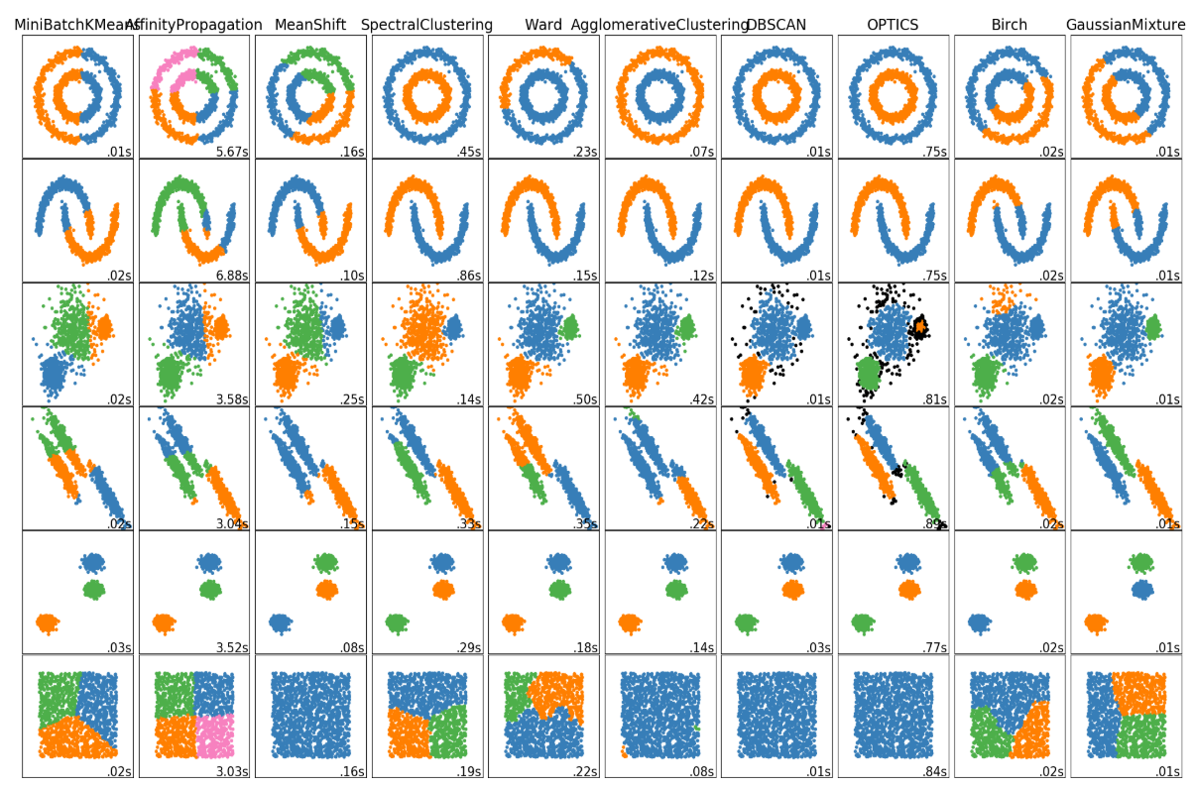
Various Models, Methods and Algorithms
Common Approaches:
Partitioning Methods
Probabilistic Models
Generative Models
Distance-Based Algorithms
Density-Based Methods
Grid-Based Methods
Need more Ph.Ds to understand it all…. don’t be a wikipedia.

Slide 17
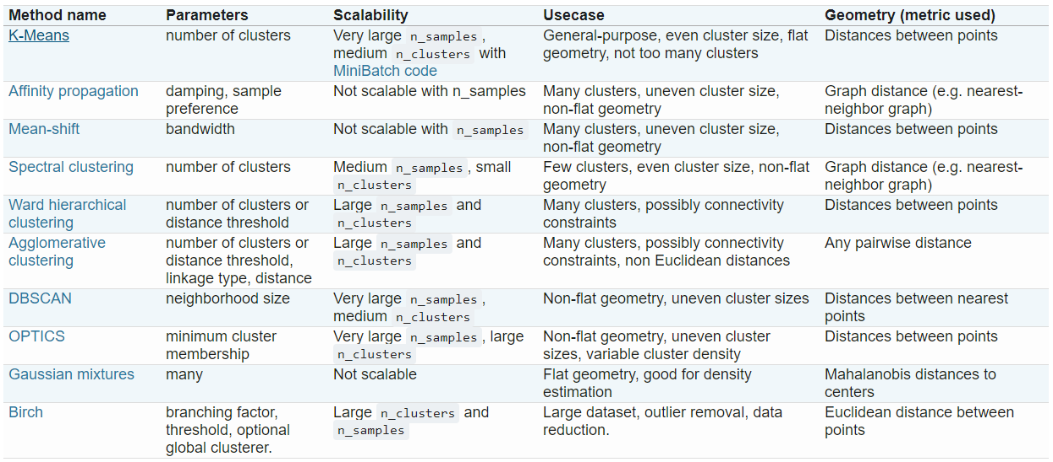
Model Comparison

Slide 18
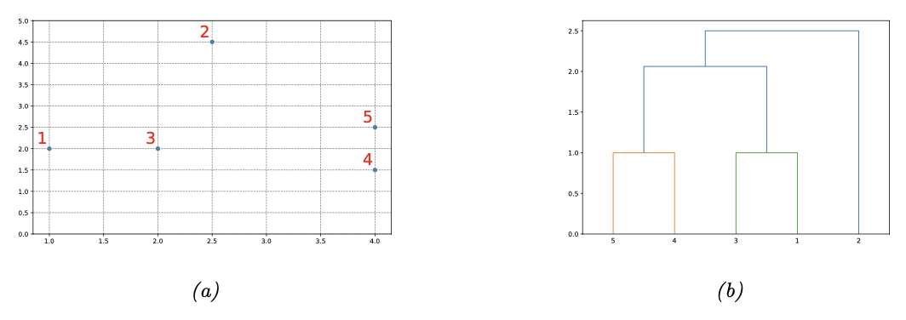
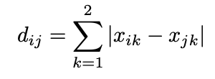
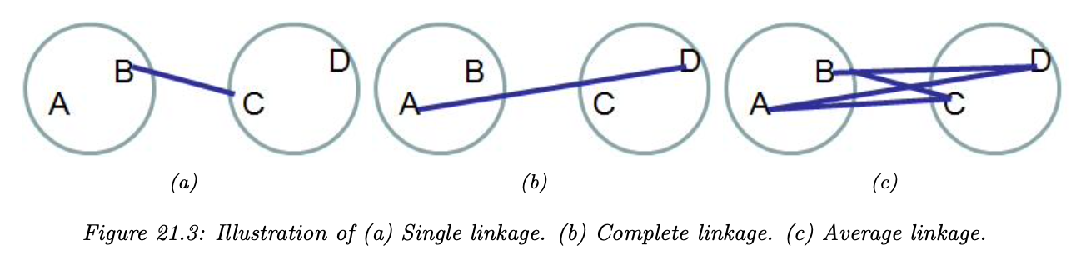
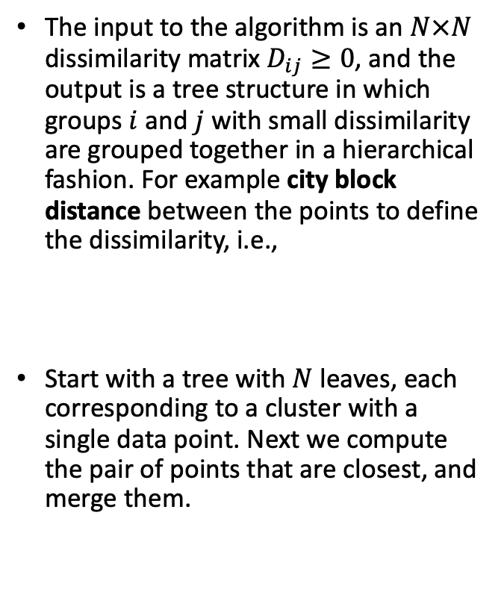
Hierarchical Agglomerative Clustering
The input to the algorithm is an $N×N$ dissimilarity matrix $D_{ij}≥0$, and the output is a tree structure in which groups $i$ and $j$ with small dissimilarity are grouped together in a hierarchical fashion. For example city block distance between the points to define the dissimilarity, i.e.,
Start with a tree with $N$ leaves, each corresponding to a cluster with a single data point. Next we compute the pair of points that are closest, and merge them.

Slide 19
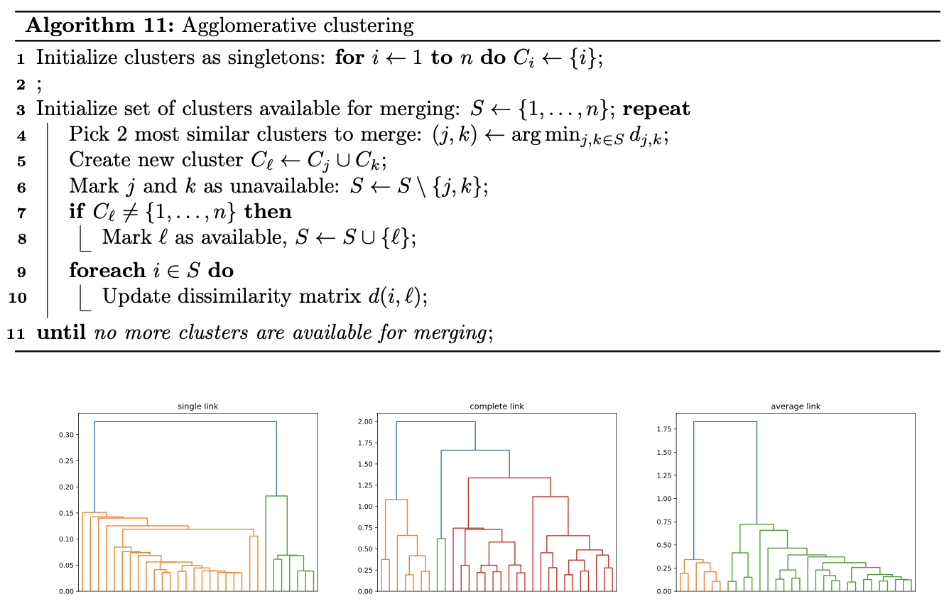
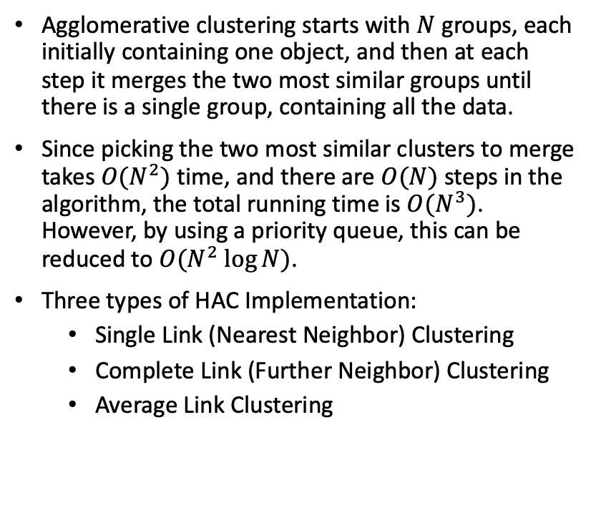
HAC Implementation
Agglomerative clustering starts with $N$ groups, each initially containing one object, and then at each step it merges the two most similar groups until there is a single group, containing all the data.
Since picking the two most similar clusters to merge takes $O(N^{2})$time, and there are $O(N)$ steps in the algorithm, the total running time is $O(N^{3})$. However, by using a priority queue, this can be reduced to $O(N^{2} log⁡N)$.
Three types of HAC Implementation:
Single Link (Nearest Neighbor) Clustering
Complete Link (Further Neighbor) Clustering
Average Link Clustering

Slide 20
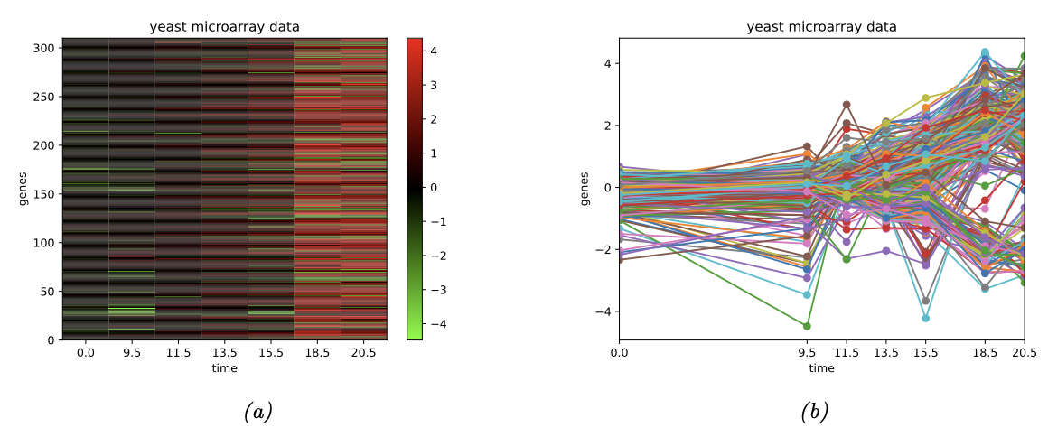
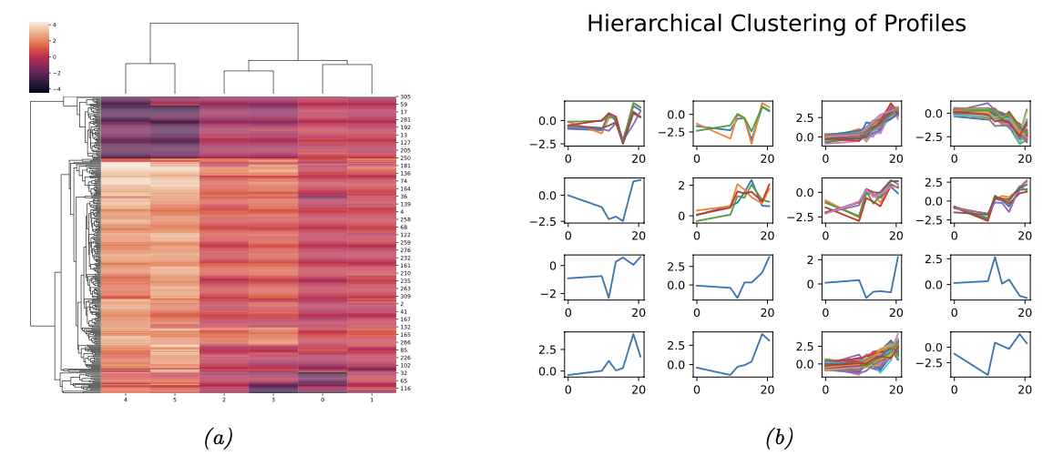
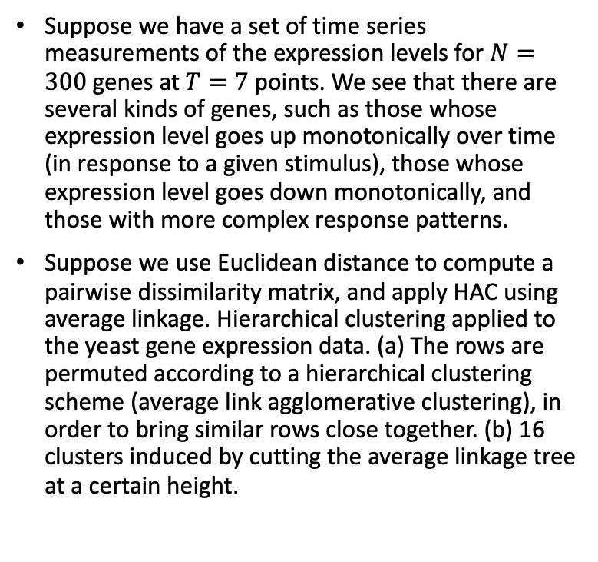
Example of HAC
Suppose we have a set of time series measurements of the expression levels for $N=300$genes at $T=7$points. We see that there are several kinds of genes, such as those whose expression level goes up monotonically over time (in response to a given stimulus), those whose expression level goes down monotonically, and those with more complex response patterns.
Suppose we use Euclidean distance to compute a pairwise dissimilarity matrix, and apply HAC using average linkage. Hierarchical clustering applied to the yeast gene expression data. (a) The rows are permuted according to a hierarchical clustering scheme (average link agglomerative clustering), in order to bring similar rows close together. (b) 16 clusters induced by cutting the average linkage tree at a certain height.

Slide 21
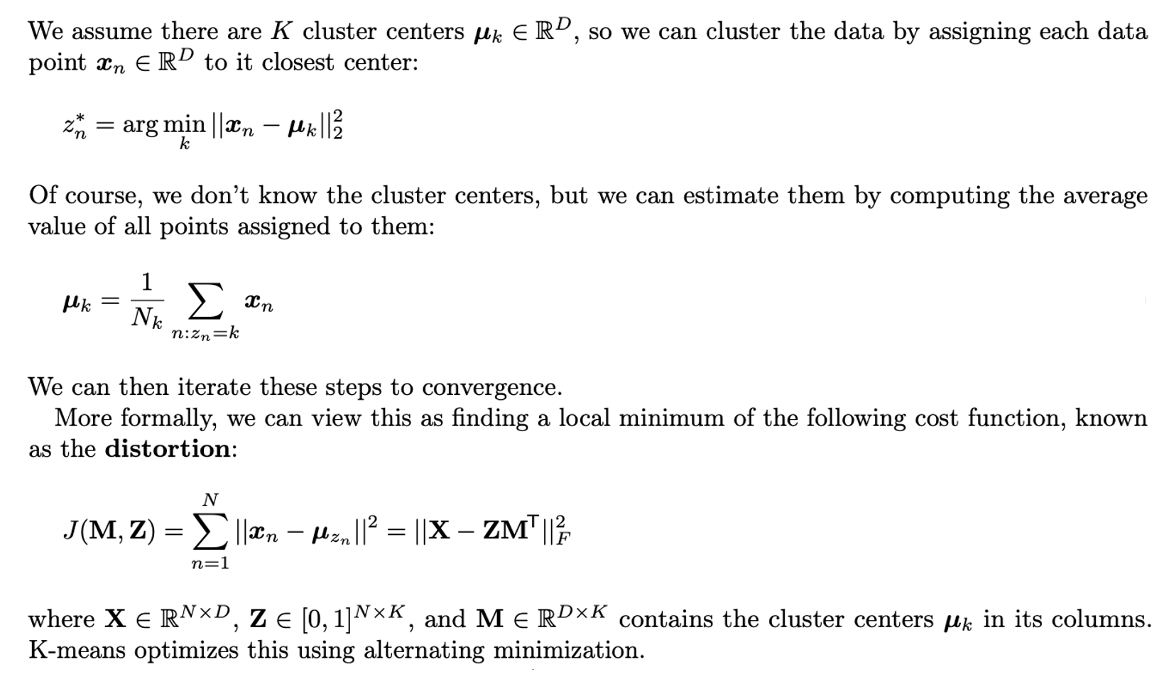
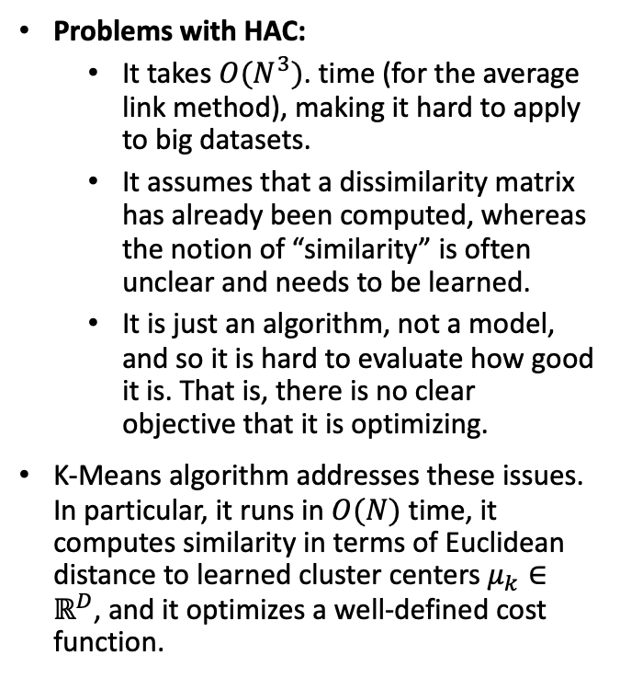
K-Means Clustering
Problems with HAC:
It takes $O(N^{3})$. time (for the average link method), making it hard to apply to big datasets.
It assumes that a dissimilarity matrix has already been computed, whereas the notion of “similarity” is often unclear and needs to be learned.
It is just an algorithm, not a model, and so it is hard to evaluate how good it is. That is, there is no clear objective that it is optimizing.
K-Means algorithm addresses these issues. In particular, it runs in $O(N)$ time, it computes similarity in terms of Euclidean distance to learned cluster centers $μ_{k}∈ℝ^{D}$, and it optimizes a well-defined cost function.
Kmeans Algorithm

Slide 22
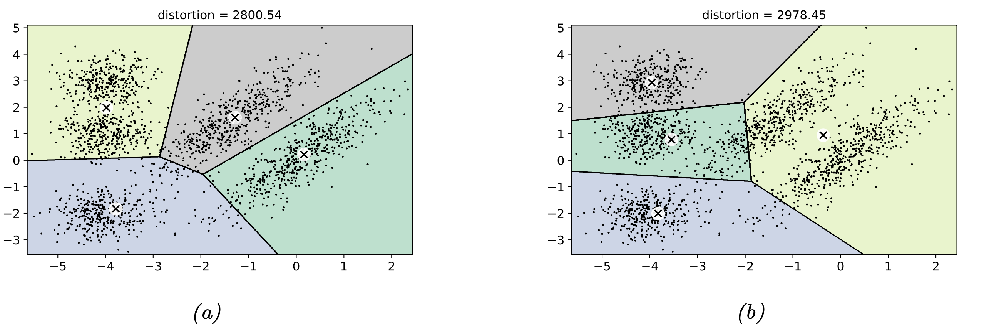
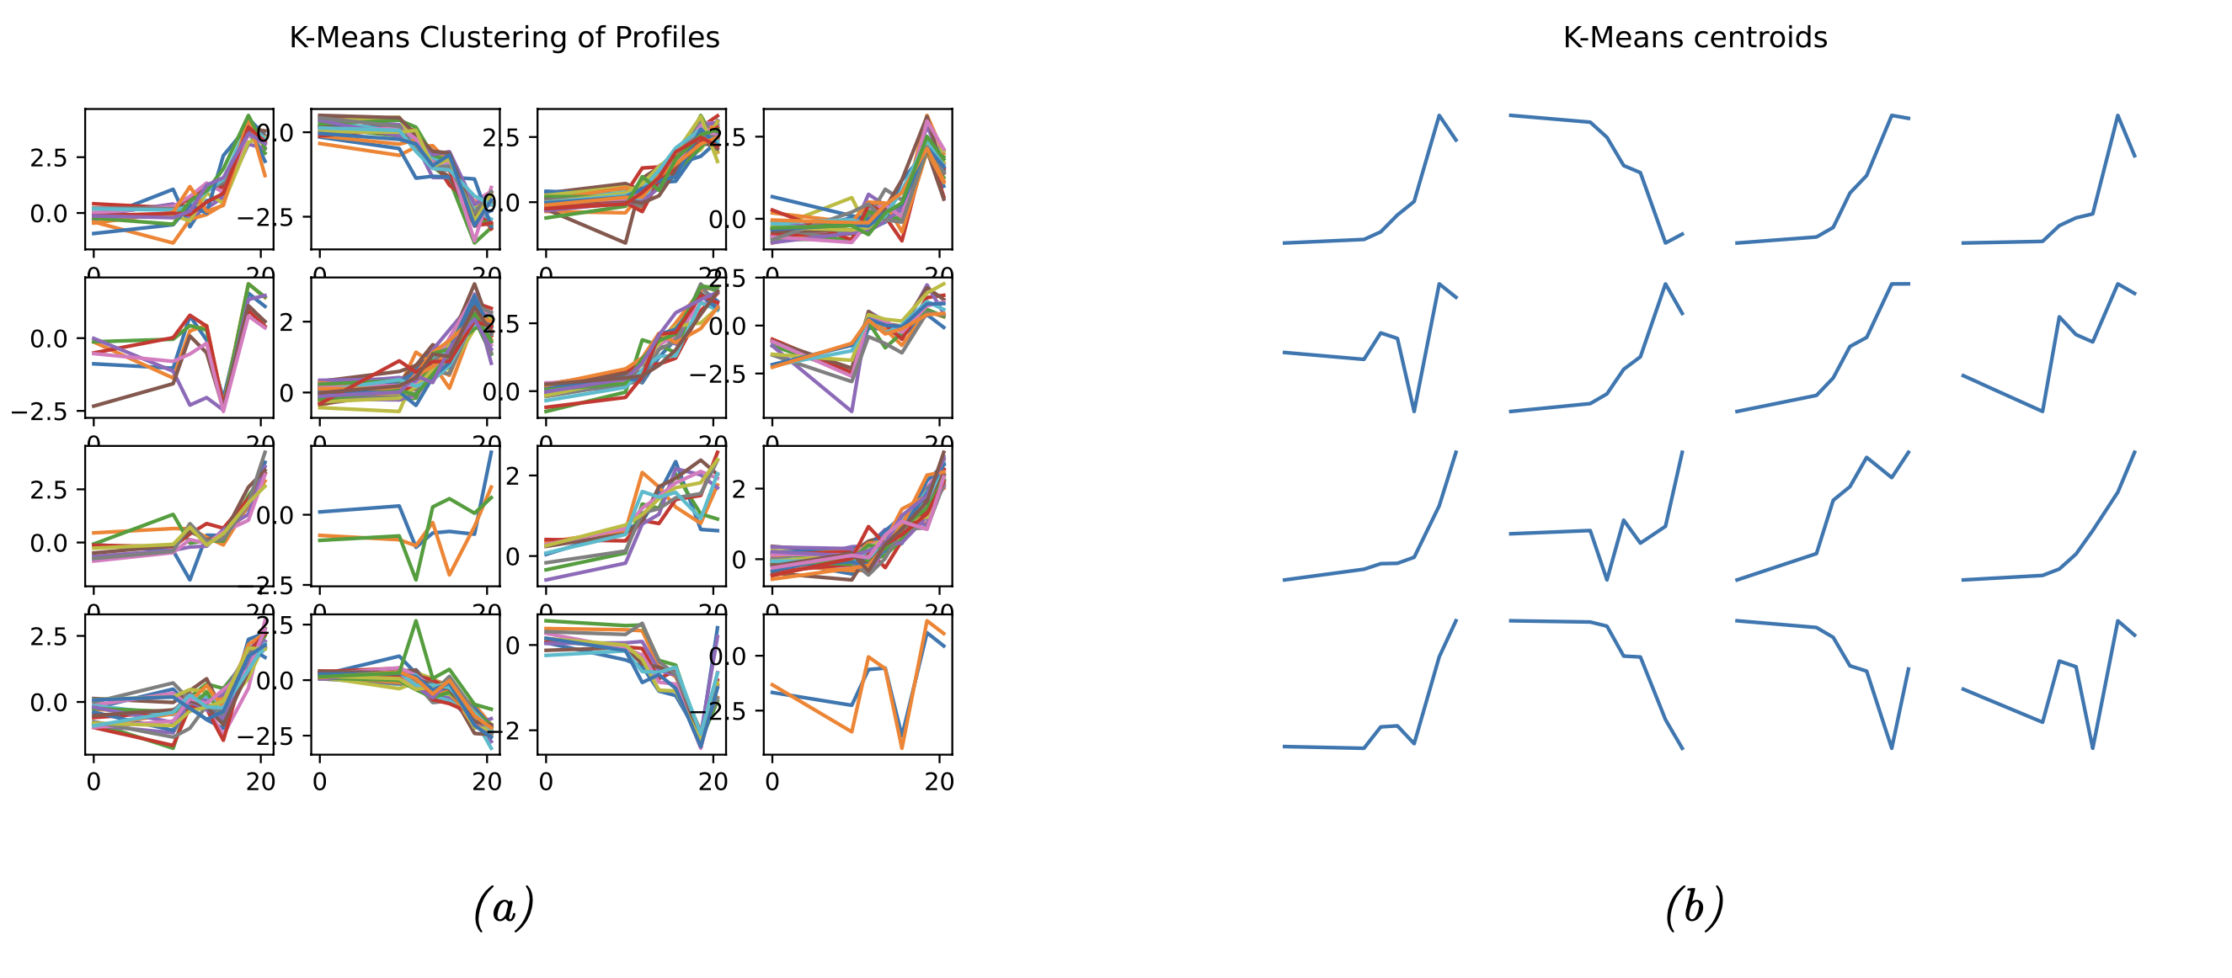
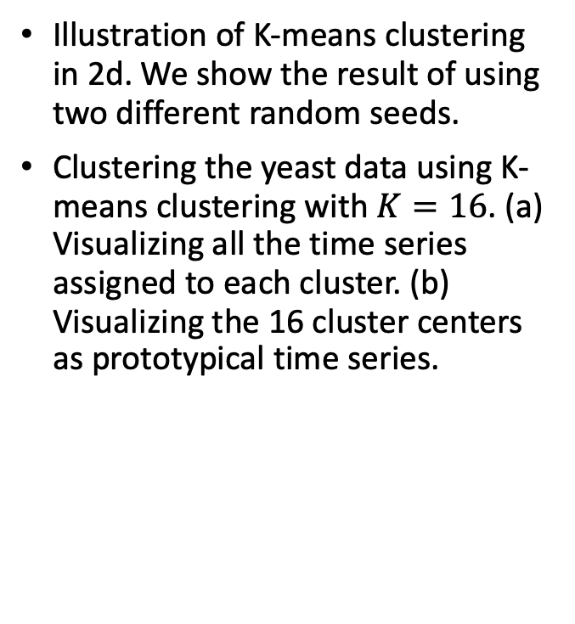
Example of K-Means
Illustration of K-means clustering in 2d. We show the result of using two different random seeds.
Clustering the yeast data using K-means clustering with $K=16$. (a) Visualizing all the time series assigned to each cluster. (b) Visualizing the 16 cluster centers as prototypical time series.

Slide 23
Outline – Data Clustering
Definition of Clustering
Features Selection and Extraction
Clustering Models and Algorithms
Clustering Validation Measures
Other Frameworks and Libraries

Slide 24
Clustering Validation Measures
Clustering Validation: measure of goodness of clustering results.
Facts: No consistent and conclusive solution to cluster validation. The best suitable measures to use in practice remain unknown.
Major Issues:
Importance of normalizing validation measures.
Relationship between different validation measures.
Selection of validation measures.
Validation for specific algorithms.
Category of techniques:
External: Use external information not presenting in the data
Internal: Use only internal information in the data
Both are crucial to apply and both have limitations

Slide 25
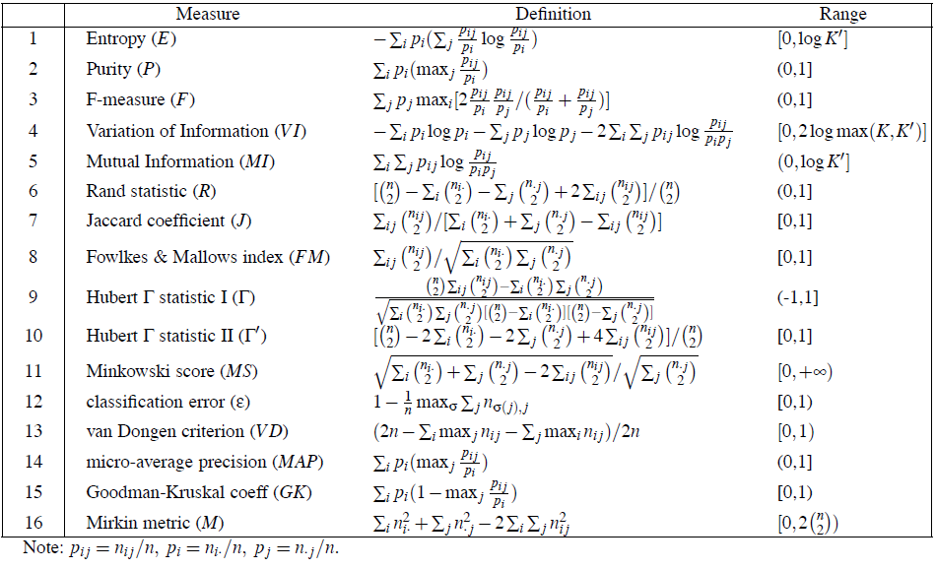
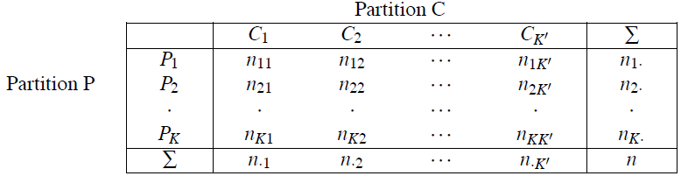
External Validation Measures
The Contingency Matrix. Given a data set D with n objects, assume that there is a partition of D, and K is the number of clusters. If the “true” class labels for the data are given, another partition can be generated on D, called C, then the information on the overlap between the two partitions can be written in the form of a contingency matrix.
Notes:
C = {C1, · · · ,CK}, where
K
i=1Ci = D and Ci
Cj = φ for 1 ≤ i = j ≤ K, where K is the number
of classes

Slide 26
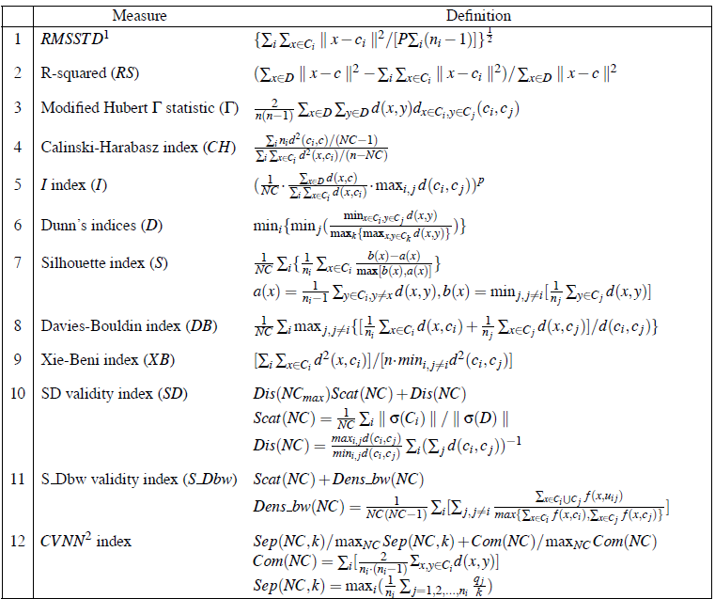
Internal Validation Measures
As the goal of clustering is to make objects within the same cluster similar and objects in different clusters distinct, internal validation measures are often based on two criteria: Compactness and Separation.
Understanding the impacts of:
Monotonicity
Noise
Density
Subclusters
Skewed Distributions
Arbitrary Shapes

Slide 27
Outline – Data Clustering
Definition of Clustering
Features Selection and Extraction
Clustering Models and Algorithms
Clustering Validation Measures
Other Frameworks and Libraries

Slide 28
OSS Frameworks and Libraries
General Purposes
WEKA
Spider
Cluster
ELKI
Specialized
OpenSubspace (Subspace Algorithm)
cross-bow (Text Data Clustering)
MALLET (Topic Modeling NLP)
CLUTO (High Dimensional Data)
Gait-CAD (Time-Series)
Cluster (Gene Expression)
METIS (Graph Partitioning)
CFinder (Nodes in Network)
Public Datasets
KDNuggets
STATOO
David Dowe Links
KDD Cup
UCR Time-Series
SNAP repository
Reuters News
20NewsGroups
TREC
Cora
Gene Expression Omnibus
Public Datasets
DIP
BioGRID
STRING
MIPS
GenBank
EMBL
PIR
UniProt
ImageCLEF
ImageNet
Autonomous Car

Slide 29

Homework
Please Reproduce the following link:
https://scikit-learn.org/stable/modules/clustering.html

Slide 30
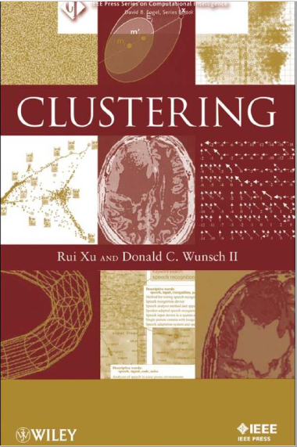
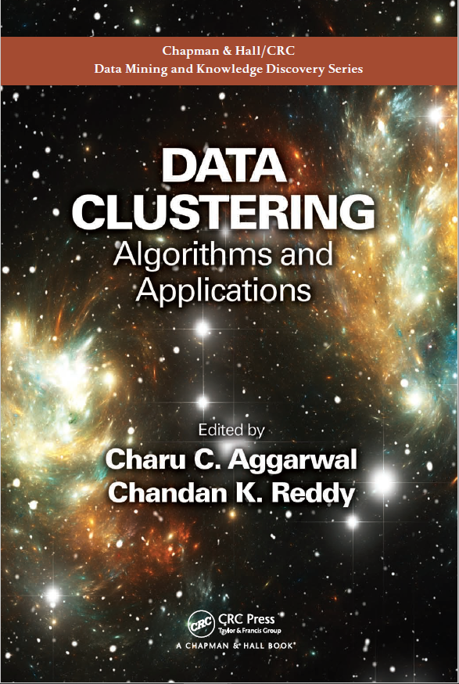
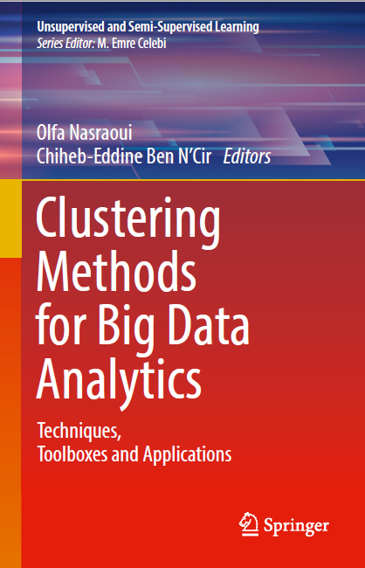
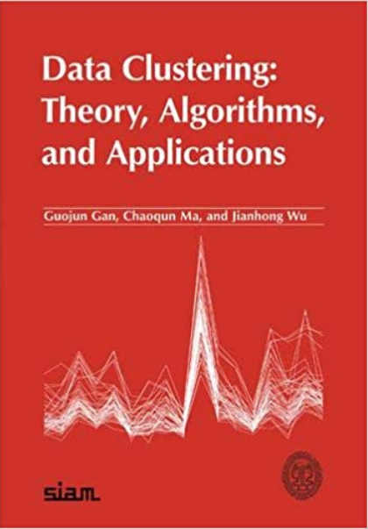
To Learn More ……(when you need it)

Slide 31

THANKS
Dr. Risman Adnan Mattotorang

